Slide 1
Web Mining of US Election News Articles
BIA 660
Group 5
Shristi Hingle
Pooja Kamat
Sourabh Rakhunde
Vijay Sarathy

Slide 2
Introduction
With the upcoming US election, there is an astounding amount of online news content.
Therefore, the amount of information is increased further by the availability of users sharing the articles that they read.

Slide 3
Motivation
Come up with a predictive algorithm for article topic and the approximate number of comments.
This will enable targeting readers better by understanding their interests.

Slide 4
Methods
We have done the following:
Scraping: Used BeautifulSoup to extract Article Content, number of comments from Yahoo News and Huffington Post (Number of shares)
LDA: grouped each article into 20 possible topic categories
Supervised Learning: used the LDA weights as features for a voting algorithm

Slide 5
Details: Scraping and LDA
Beautiful Soup and json was used to pull title, articles, and number of shares from Yahoo News, and Huffington Post.
Article content was scraped directly from the page
Facebook shares was obtained by the JSON content from an external website (upon concatenating ‘graph.facebook.com’ and the article’s link
We decided to use LDA because it can categorize the different topics that an article may fall under.

Slide 6
Details: Supervised Learning
Algorithm: Voting method (“soft” methods with weights [5,3,3]) of:
Random Forest
Bagging of Gradient Boosting Classifier
Bagging of Logistic Regression
Preprocessing: Number of Shares was converted to categorical by discretizing to 5 bins

Slide 7
Results: Scraping
About 300 were scraped
A dataset was exported that has the title, number of shares, and article content on each line (so that LDA can distinguish between the different articles)

Slide 8
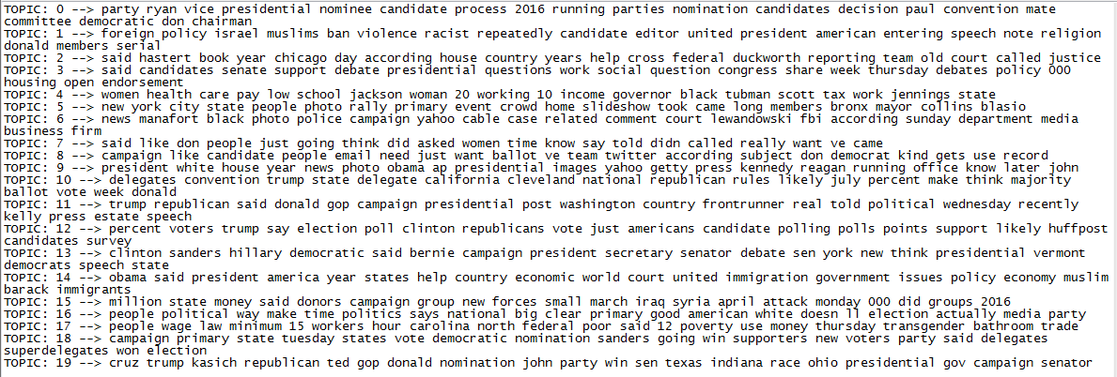
Results: LDA
A dataset was constructed of the article share amount and the weights of falling undering the 20 topics generated

Slide 9
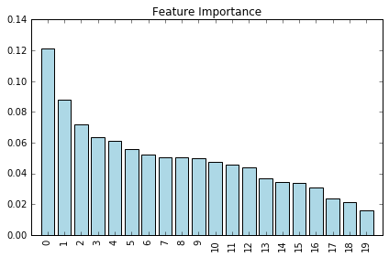
Results: Supervised Learning
Accuracy: 83.5%
Feature Importance from RF shows a range by about a factor of 5

Slide 10
Analysis
The differences in feature importances for the topics shows that certain topics (foreign policy, women’s rights, conventions,etc.) tend to have a more correlated relationship with the number of shares
The accuracy is high which is most likely due to using only 5 bins; depending on the business needs, the numbers may need to be increased at the cost of compromising accuracy (If 10 bins are used, the accuracy drops to 68.75%, while it shoots up to 93% if only 3 bins are used).

Slide 11
Conclusions
The type of content in an article does play a role in the visibility (number of shares).
Therefore, focusing on articles corresponding to the lower topic numbers will increase the amount of shares and reader activity.

